Slide 1
Monthly Update on 2018-2019 WRAP Workplan March 27th, 2019 TSC and Work Group Co-Chairs Call
Tribal Data WG
Fire and Smoke WG
Oil and Gas WG
Regional Technical Operations WG
Regional Haze Planning WG

Slide 2
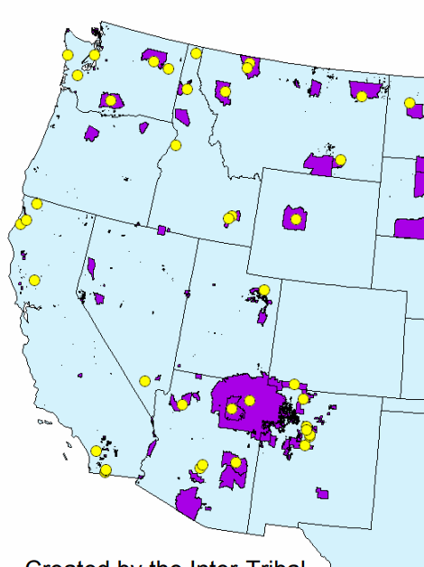
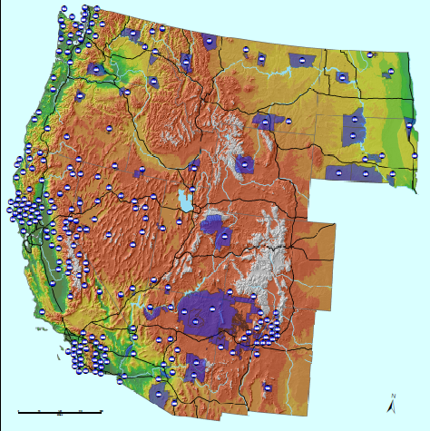
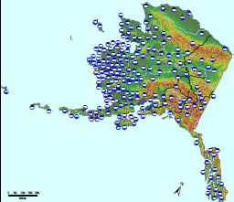
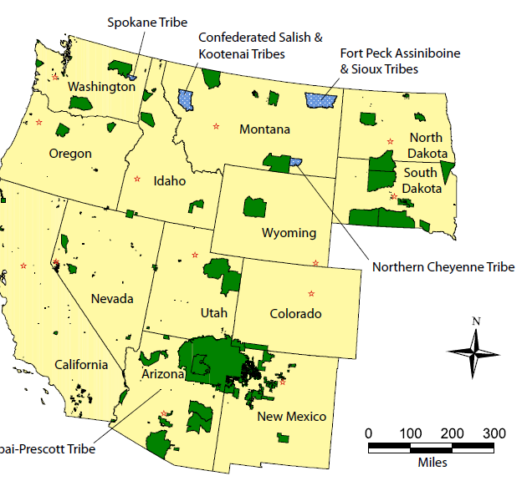
Tribal Data Work Group

Slide 3
Workplan Progress by Tribal Data Work Group
Workplan Progress over the Last Month
Updated WRAP map on webpage to better reflect Tribal involvement
Finalized several documents
Regional Air Quality and the Regional Haze Rule: Information and Resources for Tribal Professionals and PowerPoint presentation
Tribe, WRAP and the Reginal Haze Rule, Practices and Processes for Tribes to Address Regional Air Quality and PowerPoint presentation
Regional Haze, and WRAP at the National Tribal Forum on Air Quality
Scheduled webinar
Workplan Tasks for the Next Two Months
Finalize work on AQS and EIS Gap Studies
Finalize work on Tribal Oil and Gas Emission Inventory and Outreach
Finalize Tribal contact list

Slide 4
Workplan Coordination Activities by Tribal Data Work Group
Workplan Coordination Occurring over the Last Month
Kick-off for Ramboll Task 7 - Consultation and Coordination Protocol document
Call between OGWG & TDWG to confirm status of activities & plan next activities contracted for TDWG
Workplan Coordination Needed over the Next Two Months
Oil and Gas EI
Webinar schedule
Consultation and Coordination Protocol

Slide 5
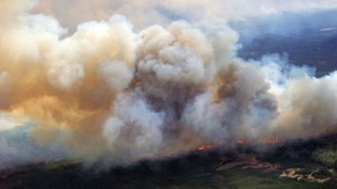
and
Fire and Smoke Work Group

Slide 6
Workplan Progress by Fire and Smoke Work Group
Workplan Progress over the Last Month
Paul Corrigan (USFS and Utah) agreed to step in as 3rd co-chair
Have had 2 more RBFFS calls, one with FSWG: March 6, 19
Working out details on process to develop representative baseline and future fire scenarios fire emissions inventories for RH modeling
Discussed new map deliverable idea for Smoke Management Plans task
Workplan Tasks for the Next Two Months
Continue to identify and implement methodologies to determine future year and multi-year baseline fire emissions for RH modeling
RBFFS next call scheduled for April 3, FSWG on May 15

Slide 7
Workplan Coordination Activities by Fire and Smoke Work Group
Workplan Coordination Occurring over the Last Month
Member overlap between RBFFS and EIMP Subcommittee and RHWG
Workplan Coordination Needed over the Next Two Months
Carry on coordinating

Slide 8
Oil and Gas Work Group

Slide 9
Workplan Progress by Oil and Gas Work Group
Workplan Progress over the Last Month
OGWG O&G Operator Surveys - Completion
Forecast Scenarios - Underway
OGWG Workplan Review & Update approved by consensus on Feb. 12 call and provided to TSC
Workplan Tasks for the Next Two Months
Task 1: Base Year Inventory – Mid-March/Early-April - Survey compilation memo
Task 2: Forecast 2028 Inventory (On-the-books controls) – Late-February/Early-April - Forecast scenarios

Slide 10
Workplan Coordination Activities by OGWG
Workplan Coordination Occurring over the Last Month
Assistance from Agencies/O&G operators to complete OGWG Survey
March 4 – Project Management Team Call
Discuss steps to wrap-up the survey effort with Ramboll.
Coordinate on the forecast scenarios and provide PMT feedback to Ramboll.
March 8 – Coordination Call on Tribal Outreach
TDWG and OGWG Co-Chairs
Assistance from Agencies on Forecast Scenarios
Workplan Coordination Needed over the Next Two Months
April 4 – Project Management Team Call
April 9 – OGWG Bi-Monthly Call
Agenda under development
Tribal Outreach Progress – invitation to TDWG contractor team (ITEP & EN3)
Assistance from Agencies on Forecast Scenarios
OGWG and PMT review and feedback on draft work products

Slide 11
Regional Technical Operations Work Group

Slide 12
Workplan Progress by RTOWG Work Group-2014 Shake-Out Project
Work Item | Completion | Comments
Phase I 2014 Shake-Out Modeling Plan | Dec 2018 | Completed
Single-Source Visibility Modeling Webinar | Dec 2018 | Completed
Single-Source Visibility Modeling Memorandum | Feb 2019
2014 Emission Inputs | Jan 2019 | Completed
2014 36-km CONUS Domain Boundary Conditions | Jan 2019 | Completed
2014 Meteorological Inputs | Jan 2019 | Completed
2014 WRF and Biogenic PGM Sensitivity Test | Feb 2019 | Completed Since Last Update
2014 Annual CAMx and CMAQ Platforms | Feb 2019 | Completed Since Last Update
Phase II Illustrative Modeling Plan (WAQS/WestJumpAQMS) | Feb 2019 | Will be completed by Apr 5
2014 Annual CMAQ and CMAQ Base Case and MPE | Mar 2019 | Will be completed by Apr 5
Transfer 2014 Platform to IWDW | Feb 2019 | Will be completed by Apr 5
2014 Shake-Out Close-Out Meeting | Apr 5, 2019 | Will be completed by Apr 5
2014 Shake-Out Report | Mar 2019

Slide 13
Final Model Configuration for V1 Model Shakeout
CAMx and CMAQ 2014 annual 36-km and 12-km simulations
2014 GEOS-Chem Boundary Conditions (GCBC)
Use updated GCBCs for Jun/Jul without volcano eruptions
12-km WRF Meteorology – WAQS 12WUS2 vs. EPA 12US2
Difficult to select based on MPE due to GCBC ozone and Jun/Jul Overestimation
Select WAQS 12WUS2 WRF meteorology based on better precip MPE and less wet deposition in summer
Emissions – MEGAN vs. BEIS biogenic emissions in 12-km domains
Select BEIS based on improved OA performance at most, but not all, sites
Setting up final 2014 Shake-Out Runs to Meeting Apr 5 Close-Out Meeting
CAMx 36/12-km should be completed

Slide 14
Monthly RTOWG Call-March 11, 2019
Discussion Topics
Consensus approval by RTOWG of 2018-19 WRAP Workplan update, especially Appendix E
GEOS-Chem global model results for boundary conditions – Gail Tonnesen
Ammonia emissions and modeling – Mike Barna
Overview of project to develop Representative Baseline and Future Fires scenarios – Matt Mavko Planning Baseline Fire EI white paper
2014 Shakeout Modeling Platform v1 status report – Ralph Morris

Slide 15
Workplan Coordination Activities by Regional Technical Operations Work Group
RTOWG Workplan Coordination Occurring over the Last Month
The RTOWG Monthly Call was held on March 11
The RTOWG Co-Chairs had biweekly calls on March 4, March 8, March 18, and March 21 to discuss coordination efforts
The RTOWG Co-Chairs had coordination calls with the Shake-out team of contractors on March 8 and March 25
Cross Coordination Activities
The RTOWG Co-Chairs had cross coordination call with the RHPWG Emission Inventory and Modeling Protocol subgroup on March 25 to discussion portions of version 2 of the 2014 EI especially in regards to the California Emission Inventory Substitution
On the Monthly RTOWG call on March 11, Matt Mavco gave a discussion on the plans from the Fire and Smoke Work group on proposals for the ‘average’ base year and ‘average’ future year fire emission inventories

Slide 16
Workplan Coordination Activities by Regional Technical Operations Work Group
Workplan Coordination Needed over the Next Two Months
Emissions updates from RHPWG EI subcommittee
Updated fire emissions from FSWG
Updated O&G emissions from OGWG

Slide 17
Regional Haze Planning Work Group

Slide 18
Workplan Progress by Regional Haze Planning Work Group
Workplan Progress over the Last Month
Consensus on the Draft Workplan
Complete Subcommittee and Workgroup restructuring
Workplan tasks for the Next Two Months
Consensus on ‘Overview of Regional Haze’ document
Potentially consensus on the WRAP Communication Framework
Restructure the RHPWG website

Slide 19
Workplan Coordination Activities by Regional Haze Planning Work Group
Workplan Coordination Occurring over the Last Month
Work with Coordination and Glide Path SC in planning a Milestone Webinar in March to discuss monitoring data and control measures
Coordination with all subcommittees to move work products through the consensus process
TSS Website information
Workplan Coordination Needed over the Next Two Months
Finalize consensus on WRAP Communication Framework
Q & A Follow-up on March Milestone Webinar
Coordinate with RTOWG on the Shakeout and next webinar
Develop or finalize informational documents and plan for future informational webinars as new information becomes available on the TSS v2

Slide 20
Coordination and Glide Path Subcommittee
Workplan Progress over the Last Month
Informational webinar on Monitoring Data and Trends, Source Identification Protocol, and Tribal Maps Update March 20, 2019
Consensus on TSS Website information
Workplan Tasks for the Next Two Months
Development of or consensus for informational documents in support of SIP planning.
Development of next quarterly informational webinar as new information becomes available on the TSS v2
Consensus on WRAP Communication Framework
Subcommittee Coordination
Input from MDGP Subcommittee members on TSS v.2 data
Coordinate with Modeling/Emissions Inventory SC for planning next webinar
Coordinate with Tribal Data to complete the Communication Framework

Slide 21
Monitoring Data & Glide Path Tasks
Workplan Progress over the Last Month
Now part of the Coordination & Glide Path Subcommittee
Outline tasks for future contractor work on natural conditions
Assist in upcoming monitoring data webinar
Coordination with RTOWG on URP adjustment
Workplan Tasks for the Next Two Months
Develop trend analysis methodology white paper
Subcommittee Coordination
Coordination with RTOWG on URP adjustment
May increase interaction with EPA and with IMPROVE Subcommittee to develop method for determining Glide Path 2064 endpoint (future)

Slide 22
Emissions Inventory and Modeling Protocol Subcommittee
Workplan Progress over the Last Month
Finalized Recommendations for Base Year Modeling
Workplan Tasks for the Next Two Months
Evaluate, Refine, and Process Base Year Inventory
Finalize Emissions Representativeness for baseline forecasting
Subcommittee Coordination
Coordination with RTOWG to complete the modeling shakeout
Coordinating with RHPWG for consensus on work products

Slide 23
Control Measures Subcommittee
Workplan Progress over the Last Month
Reasonable Progress Source Identification and Analysis Protocol prepared for docketing
Contractor working on Q/d analysis
Workplan Tasks for the Next Two Months
Finish Q/d analysis
Discuss Q/d analysis work product on upcoming call
Step down to bi-monthly calls after March call
Subcommittee Coordination
EI&MP Subcommittee

Slide 24
End of Workplan Progress Update

Slide 25
Workplan Progress by (insert name) Work Group
Workplan Progress over the Last Month
Example bullets
Draft report out for review
Provided feedback to contractor regarding IMPROVE data substitution
Workplan Tasks for the Next Two Months
Example bullets
Finalize draft report
Review final contractor recommendations on data substitution

Slide 26
Workplan Coordination Activities by (insert name) Work Group
Workplan Coordination Occurring over the Last Month
Who did you coordinate with, what topics were discussed, and when did it occur (replace this text with you own)
Workplan Coordination Needed over the Next Two Months
What activities do you need to coordinate on, with whom, and expected timeframe (replace this text with you own)

